Slide 1

Chapter 10
Cryptographic Hash Function

Slide 2
Outlines
Hash Function and Cryptographic Hash Function.
Applications of Hash Function.
Cryptanalysis on Hash Function.
Types of Practical Hash Functions.

Slide 3
Learning Objectives
In the end of this Chapter 10, students will be able:
To understand the hash function and its importance in cryptography.
To understand the properties and requirements of cryptographic hash function.
To understand the applications of cryptographic hash function.
To understand the cryptanalysis on hash function.
To understand some practical cryptographic hash functions.

Slide 4
HASH FUNCTION & CRYPTOGRAPHIC HASH FUNCTION

Slide 5
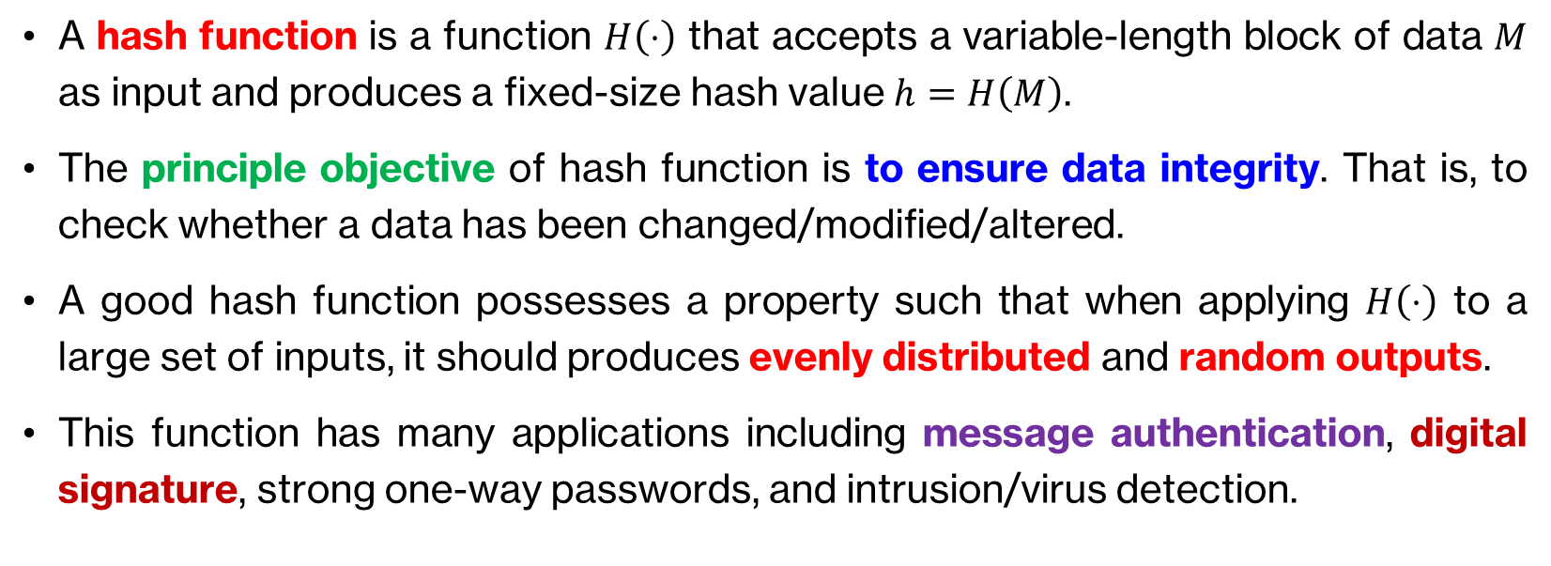
Hash Function
A hash function is a function $H\left(⋅\right)$ that accepts a variable-length block of data $M$ as input and produces a fixed-size hash value $h=H\left(M\right)$.
The principle objective of hash function is to ensure data integrity. That is, to check whether a data has been changed/modified/altered.
A good hash function possesses a property such that when applying $H\left(⋅\right)$ to a large set of inputs, it should produces evenly distributed and random outputs.
This function has many applications including message authentication, digital signature, strong one-way passwords, and intrusion/virus detection.

Slide 6
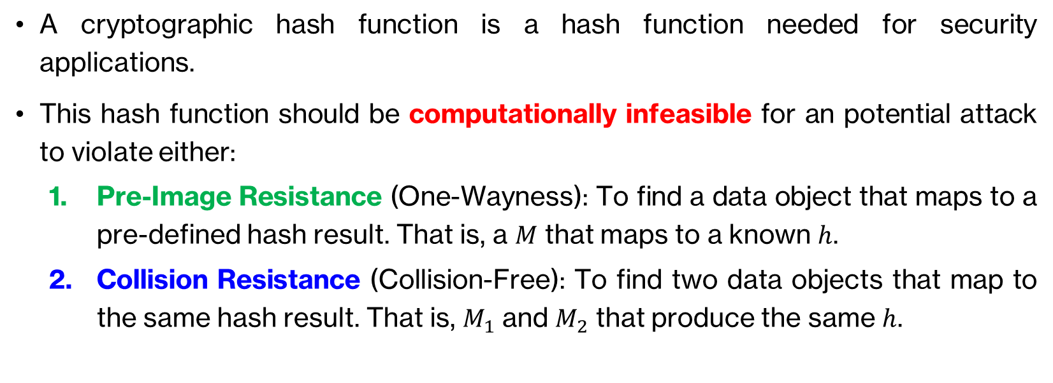
Cryptographic Hash Function
A cryptographic hash function is a hash function needed for security applications.
This hash function should be computationally infeasible for an potential attack to violate either:
Pre-Image Resistance (One-Wayness): To find a data object that maps to a pre-defined hash result. That is, a $M$ that maps to a known $h$.
Collision Resistance (Collision-Free): To find two data objects that map to the same hash result. That is, $M_{1}$ and $M_{2}$ that produce the same $h$.

Slide 7
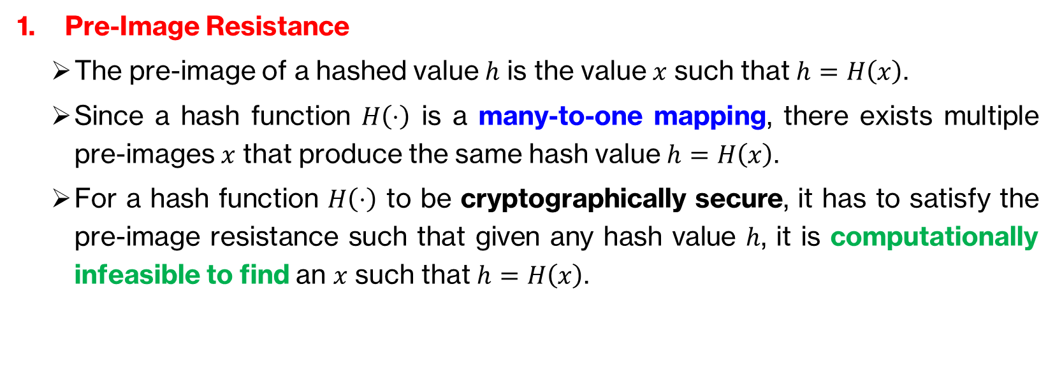
Cryptographic Hash Function - Requirements
Pre-Image Resistance
The pre-image of a hashed value $h$ is the value $x$ such that $h=H\left(x\right)$.
Since a hash function $H\left(⋅\right)$ is a many-to-one mapping, there exists multiple pre-images $x$ that produce the same hash value $h=H\left(x\right)$.
For a hash function $H\left(⋅\right)$ to be cryptographically secure, it has to satisfy the pre-image resistance such that given any hash value $h$, it is computationally infeasible to find an $x$ such that $h=H\left(x\right)$.

Slide 8
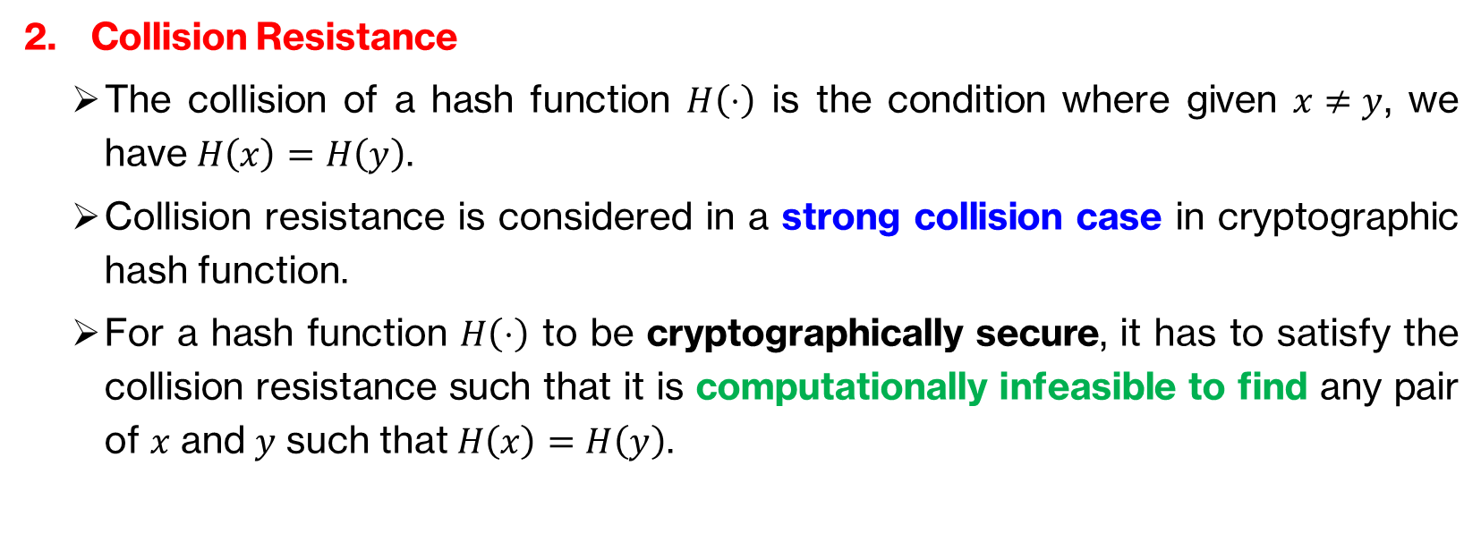
Cryptographic Hash Function - Requirements
Collision Resistance
The collision of a hash function $H\left(⋅\right)$ is the condition where given $x≠y$, we have $H\left(x\right)=H\left(y\right)$.
Collision resistance is considered in a strong collision case in cryptographic hash function.
For a hash function $H\left(⋅\right)$ to be cryptographically secure, it has to satisfy the collision resistance such that it is computationally infeasible to find any pair of $x$ and $y$ such that $H\left(x\right)=H\left(y\right)$.

Slide 9
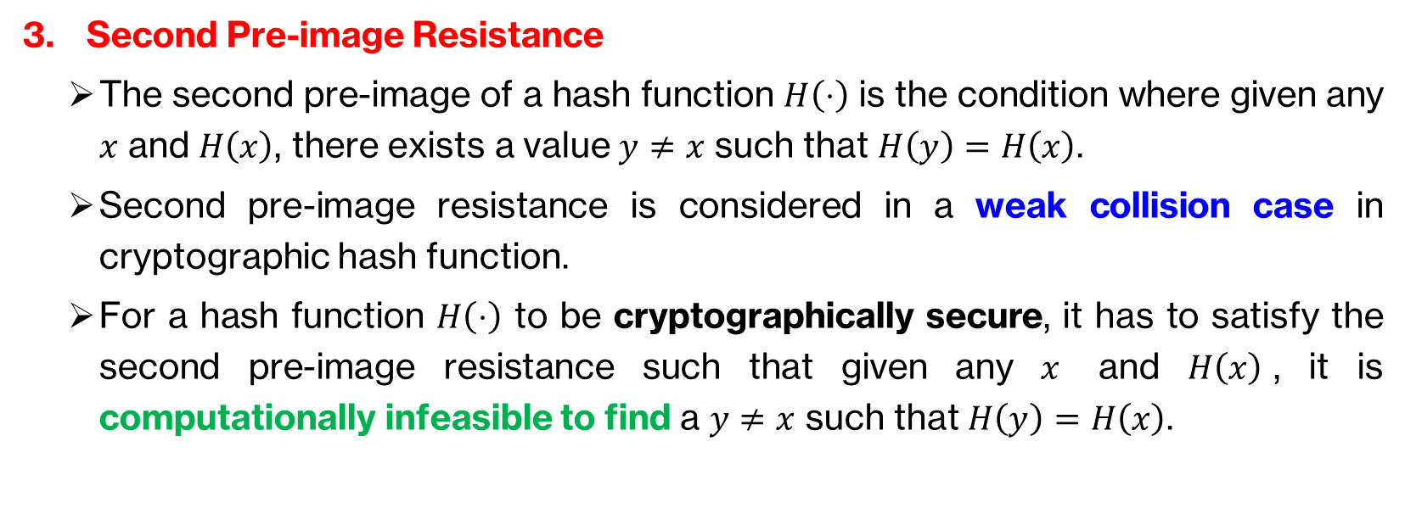
Cryptographic Hash Function - Requirements
Second Pre-image Resistance
The second pre-image of a hash function $H\left(⋅\right)$ is the condition where given any $x$ and $H\left(x\right)$, there exists a value $y≠x$ such that $H\left(y\right)=H\left(x\right)$.
Second pre-image resistance is considered in a weak collision case in cryptographic hash function.
For a hash function $H\left(⋅\right)$ to be cryptographically secure, it has to satisfy the second pre-image resistance such that given any $x$ and $H\left(x\right)$, it is computationally infeasible to find a $y≠x$ such that $H\left(y\right)=H\left(x\right)$.

Slide 11
APPLICATIONS OF HASH FUNCTION: MESSAGE AUTHENTICATION

Slide 12
Message Authentication
Message authentication is a mechanism or service used to verify the integrity of a message.
It ensures that the data received are exactly as sent (no modification, insertion, deletion, or replay).
It assures that the identify of the sender is valid/authentic.
When a hash function is used to provide message authentication, the hash function value is called as a message digest .

Slide 13
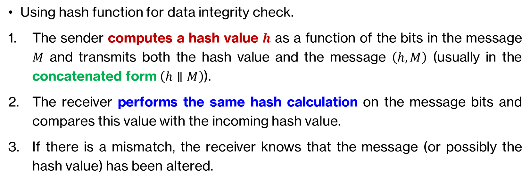
Message Authentication
Using hash function for data integrity check.
The sender computes a hash value $h$ as a function of the bits in the message $M$ and transmits both the hash value and the message $\left(h,M\right)$ (usually in the concatenated form $\left(h∥M\right)$).
The receiver performs the same hash calculation on the message bits and compares this value with the incoming hash value.
If there is a mismatch, the receiver knows that the message (or possibly the hash value) has been altered.

Slide 14
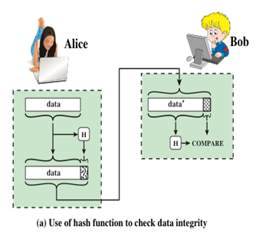
Message Authentication

Slide 15
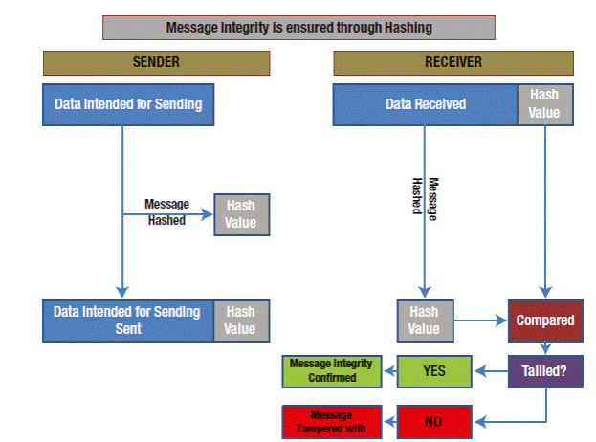

Slide 16
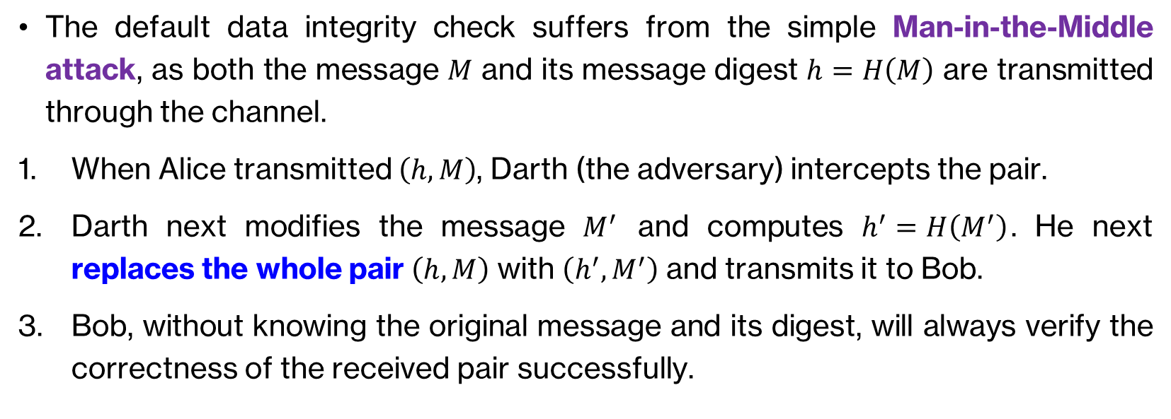
Message Authentication – Security Issue
The default data integrity check suffers from the simple Man-in-the-Middle attack, as both the message $M$ and its message digest $h=H\left(M\right)$ are transmitted through the channel.
When Alice transmitted $\left(h,M\right)$, Darth (the adversary) intercepts the pair.
Darth next modifies the message $M^{′}$ and computes $h^{′}=H\left(M^{′}\right)$. He next replaces the whole pair $\left(h,M\right)$ with $\left(h^{′},M^{′}\right)$ and transmits it to Bob.
Bob, without knowing the original message and its digest, will always verify the correctness of the received pair successfully.

Slide 17
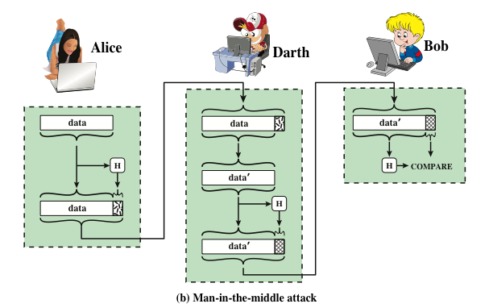

Slide 18
Secure Message Authentication
Hence, there is a need to provide alternative ways of ensuring a secure message authentication through hash function.
In the next few slides, we discuss and observe the four different alternatives of achieving secure message authentication using hash function.

Slide 19
Secure Message Authentication – Alternative 1
The message plus concatenated hash code is encrypted using symmetric encryption.
Since only A and B has the secret key, the message must be from A and has not been altered.
The hash code ensures the message authentication.
Confidentiality is also provided since the encryption is applied to the entire message plus hash code.

Slide 20
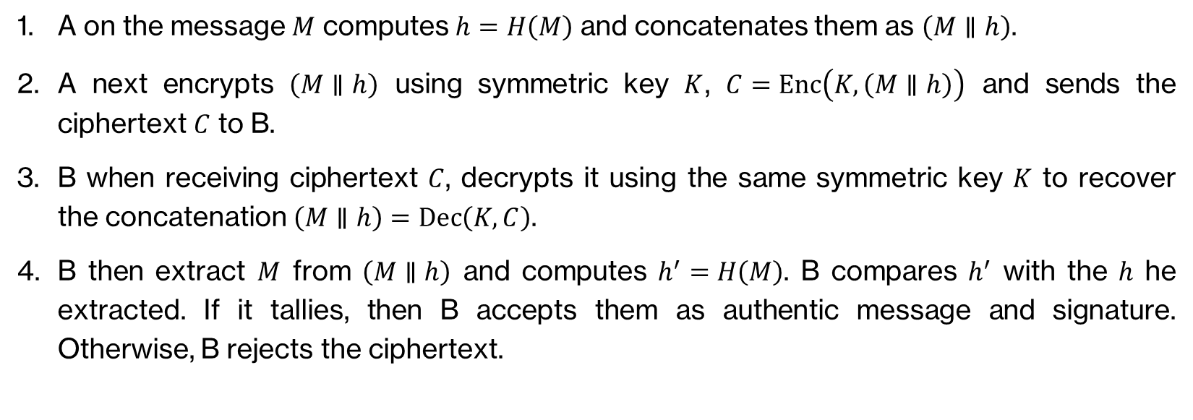
A on the message $M$ computes $h=H\left(M\right)$ and concatenates them as $\left(M∥h\right)$.
A next encrypts $\left(M∥h\right)$ using symmetric key $K$, $C=Enc\left(K,\left(M∥h\right)\right)$ and sends the ciphertext $C$ to B.
B when receiving ciphertext $C$, decrypts it using the same symmetric key $K$ to recover the concatenation $\left(M∥h\right)=Dec\left(K,C\right)$.
B then extract $M$ from $\left(M∥h\right)$ and computes $h^{′}=H\left(M\right)$. B compares $h^{′}$ with the $h$ he extracted. If it tallies, then B accepts them as authentic message and signature. Otherwise, B rejects the ciphertext.

Slide 21
Secure Message Authentication – Alternative 2
Only the hash code is encrypted, using symmetric encryption.
This reduces the processing burden for those applications that do not require confidentiality.

Slide 22
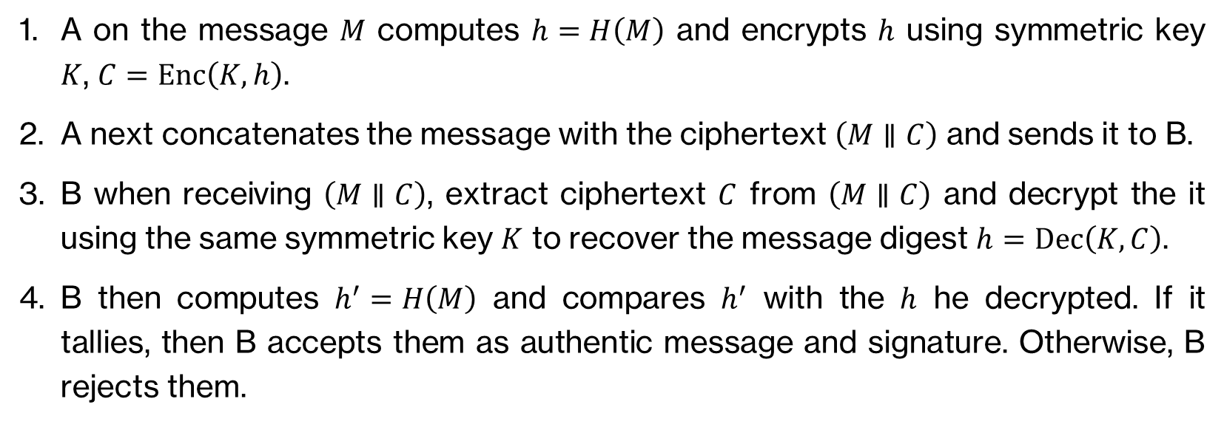
Secure Message Authentication – Alternative 2
A on the message $M$ computes $h=H\left(M\right)$ and encrypts $h$ using symmetric key $K$, $C=Enc\left(K,h\right)$.
A next concatenates the message with the ciphertext $\left(M∥C\right)$ and sends it to B.
B when receiving $\left(M∥C\right)$, extract ciphertext $C$ from $\left(M∥C\right)$ and decrypt the it using the same symmetric key $K$ to recover the message digest $h=Dec\left(K,C\right)$.
B then computes $h^{′}=H\left(M\right)$ and compares $h^{′}$ with the $h$ he decrypted. If it tallies, then B accepts them as authentic message and signature. Otherwise, B rejects them.

Slide 23
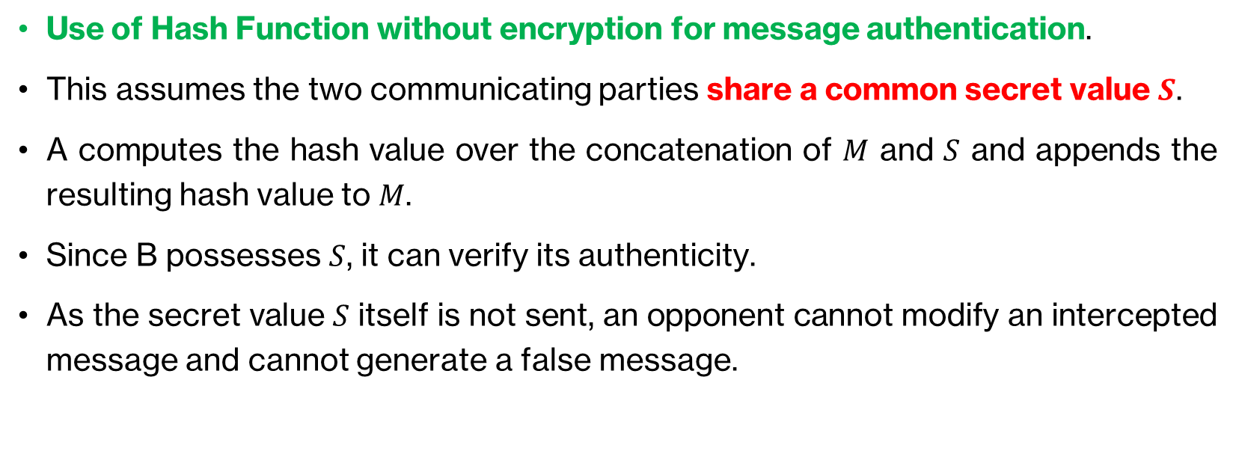
Secure Message Authentication – Alternative 3
Use of Hash Function without encryption for message authentication.
This assumes the two communicating parties share a common secret value $S$.
A computes the hash value over the concatenation of $M$ and $S$ and appends the resulting hash value to $M$.
Since B possesses $S$, it can verify its authenticity.
As the secret value $S$ itself is not sent, an opponent cannot modify an intercepted message and cannot generate a false message.

Slide 24
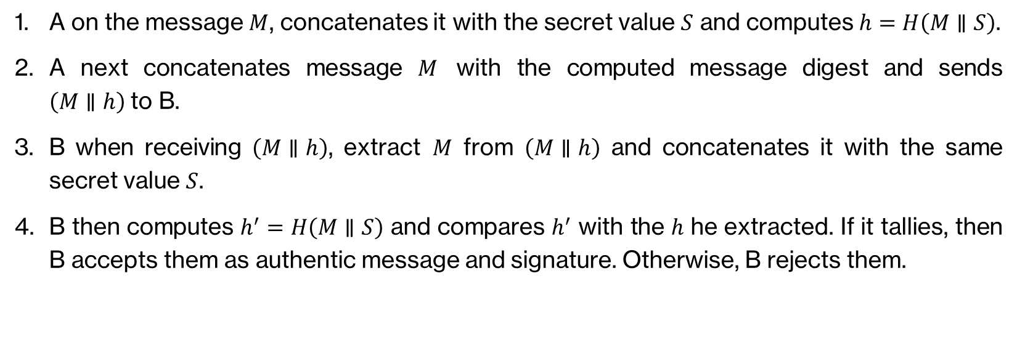
A on the message $M$, concatenates it with the secret value $S$ and computes $h=H\left(M∥S\right)$.
A next concatenates message $M$ with the computed message digest and sends $\left(M∥h\right)$to B.
B when receiving $\left(M∥h\right)$, extract $M$ from $\left(M∥h\right)$ and concatenates it with the same secret value $S$.
B then computes $h^{′}=H\left(M∥S\right)$ and compares $h^{′}$ with the $h$ he extracted. If it tallies, then B accepts them as authentic message and signature. Otherwise, B rejects them.

Slide 25
Secure Message Authentication – Alternative 4
Confidentiality can be added to the Alternative 3 by encrypting the entire message plus the hash code.

Slide 26
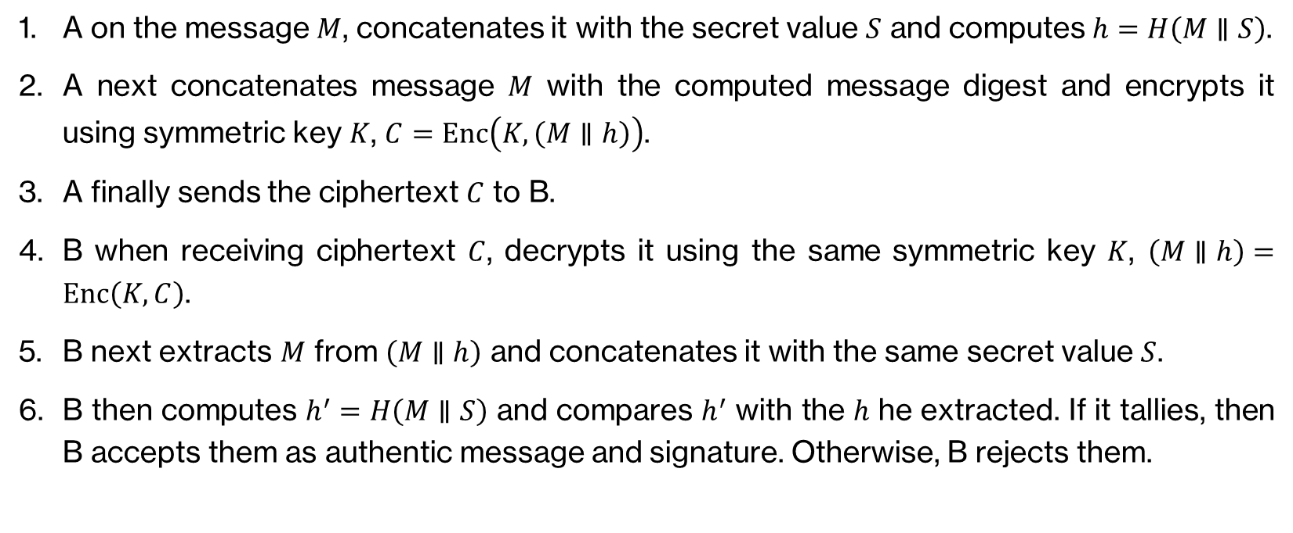
Secure Message Authentication – Alternative 4
A on the message $M$, concatenates it with the secret value $S$ and computes $h=H\left(M∥S\right)$.
A next concatenates message $M$ with the computed message digest and encrypts it using symmetric key $K$, $C=Enc\left(K,\left(M∥h\right)\right)$.
A finally sends the ciphertext $C$ to B.
B when receiving ciphertext $C$, decrypts it using the same symmetric key $K$, $\left(M∥h\right)=Enc\left(K, C\right)$.
B next extracts $M$ from $\left(M∥h\right)$ and concatenates it with the same secret value $S$.
B then computes $h^{′}=H\left(M∥S\right)$ and compares $h^{′}$ with the $h$ he extracted. If it tallies, then B accepts them as authentic message and signature. Otherwise, B rejects them.

Slide 27
Authentication vs Encryption
In some applications, where confidentiality is not required, it is desirable to avoid encryption when performing authentication.
Encryption software is relatively slow. Even though the amount of data to be encrypted per message is small, there may be a steady stream of messages into and out of a system.
Encryption hardware costs are not negligible. Low-cost chip implementations of DES are available, but the cost adds up if all nodes in a network must have this capability.

Slide 28
Authentication vs Encryption
Encryption hardware is optimized toward large data sizes. For small blocks of data, a high proportion of the time is spent in initialization/invocation overhead.
Encryption algorithms may be covered by patents, and there is a cost associated with licensing their use.

Slide 29
APPLICATIONS OF HASH FUNCTION: MESSAGE AUTHENTICATION CODE (MAC)

Slide 30
Message Authentication Code (MAC)
Also known as keyed hash function, it is typically used between two parties that share a secret key to authenticate information exchanged between those parties.
The algorithm takes in a secret key and a data block as inputs and produces MAC which is associated with the protected message.
If the integrity of the message needs to be checked, the MAC function can be applied to the message and the result compared with the associated MAC value.
An attacker who alters the message will be unable to alter the associated MAC value without the knowledge of the secret key.

Slide 31
APPLICATIONS OF HASH FUNCTION: DIGITAL SIGNATURE

Slide 32
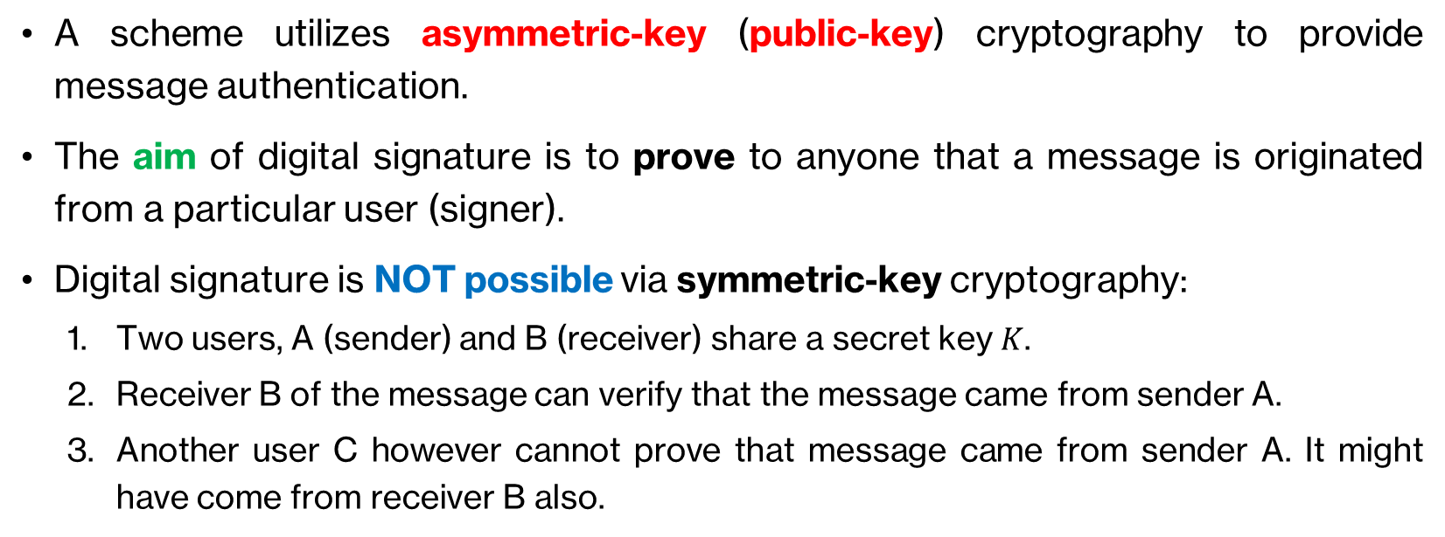
Digital Signature
A scheme utilizes asymmetric-key (public-key) cryptography to provide message authentication.
The aim of digital signature is to prove to anyone that a message is originated from a particular user (signer).
Digital signature is NOT possible via symmetric-key cryptography:
Two users, A (sender) and B (receiver) share a secret key $K$.
Receiver B of the message can verify that the message came from sender A.
Another user C however cannot prove that message came from sender A. It might have come from receiver B also.

Slide 33
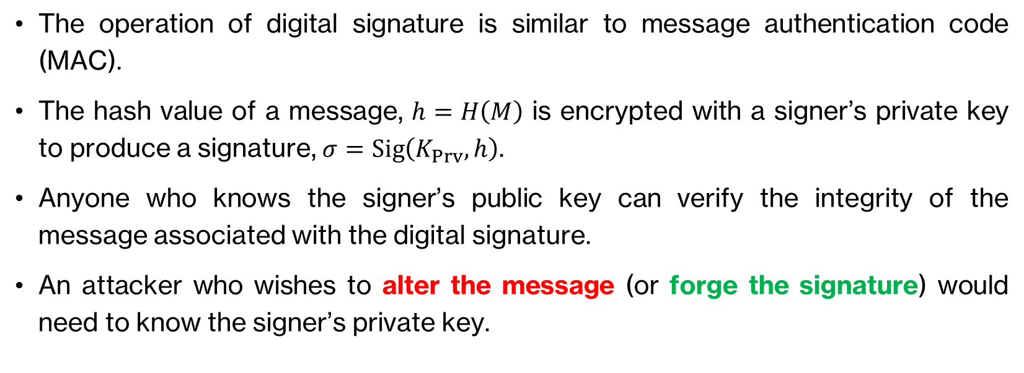
Digital Signature
The operation of digital signature is similar to message authentication code (MAC).
The hash value of a message, $h=H\left(M\right)$ is encrypted with a signer’s private key to produce a signature, $σ=Sig\left(K_{Prv},h\right)$.
Anyone who knows the signer’s public key can verify the integrity of the message associated with the digital signature.
An attacker who wishes to alter the message (or forge the signature) would need to know the signer’s private key.

Slide 34
Digital Signature – First Approach
The hash code is encrypted, using public-key encryption with the sender’s private key.
This provides authentication and a digital signature, because only the sender could have produced the encrypted hash code.

Slide 35
Digital Signature – Second Approach
If confidentiality and a digital signature is desired, then the message plus the private-key-encrypted hash code can be encrypted using a symmetric secret key.

Slide 36
APPLICATIONS OF HASH FUNCTION: OTHER APPLICATIONS

Slide 37
Other Application of Hash Functions
Creation of a one-way password file.
When a user enters a password, the hash of that password is compared to the stored hash value for verification.
This approach to password protection is used by most operating systems.

Slide 38
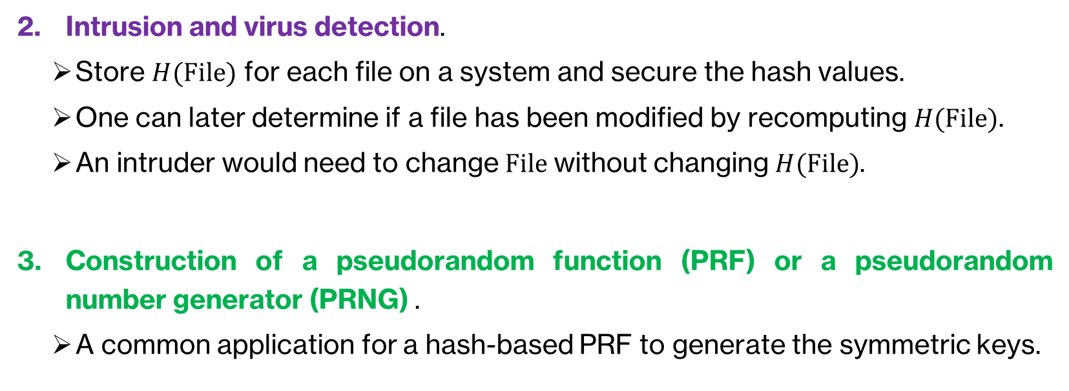
Other Application of Hash Functions
Intrusion and virus detection.
Store $H(File)$ for each file on a system and secure the hash values.
One can later determine if a file has been modified by recomputing $H(File)$.
An intruder would need to change $File$ without changing $H(File)$.
Construction of a pseudorandom function (PRF) or a pseudorandom number generator (PRNG) .
A common application for a hash-based PRF to generate the symmetric keys.

Slide 39
Application of Hash Functions – Requirements

Slide 40
ATTACKS & CRYPTANALYSIS ON HASH FUNCTION

Slide 41
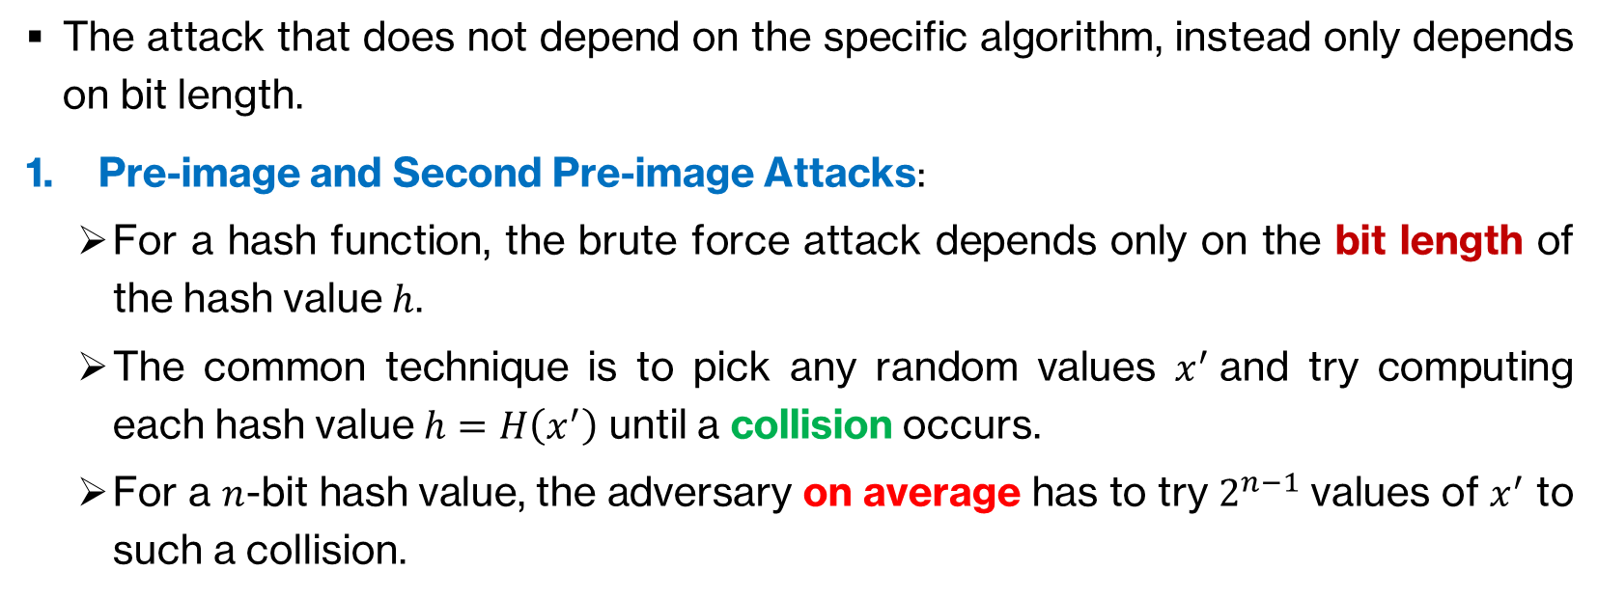
Brute-Force Attacks on Hash Function
The attack that does not depend on the specific algorithm, instead only depends on bit length.
Pre-image and Second Pre-image Attacks:
For a hash function, the brute force attack depends only on the bit length of the hash value $h$.
The common technique is to pick any random values $x^{′}$and try computing each hash value $h=H\left(x^{′}\right)$ until a collision occurs.
For a $n$-bit hash value, the adversary on average has to try $2^{n−1}$ values of $x^{′}$ to such a collision.

Slide 42
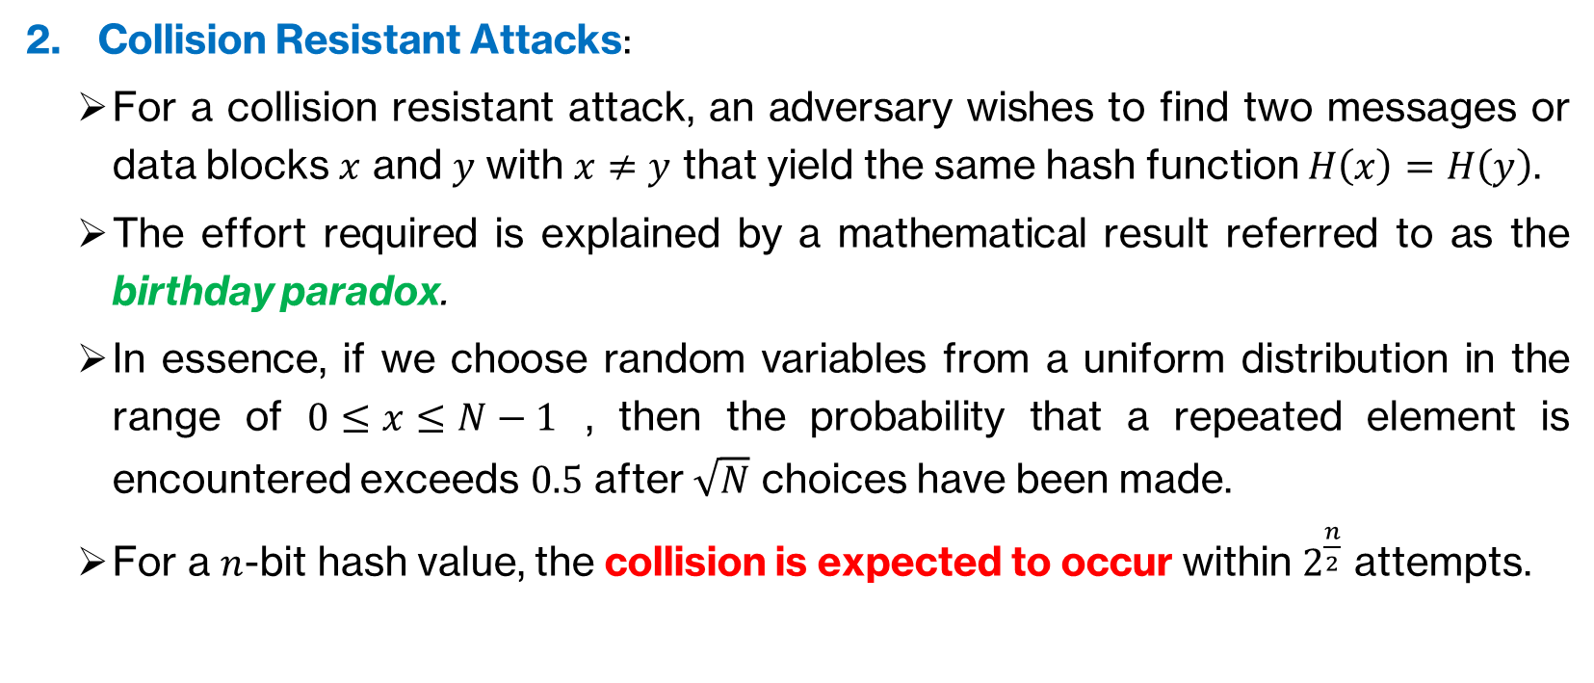
Brute-Force Attacks on Hash Function
Collision Resistant Attacks:
For a collision resistant attack, an adversary wishes to find two messages or data blocks $x$ and $y$ with $x≠y$ that yield the same hash function $H\left(x\right)=H\left(y\right)$.
The effort required is explained by a mathematical result referred to as the birthday paradox.
In essence, if we choose random variables from a uniform distribution in the range of $0≤x≤N−1$ , then the probability that a repeated element is encountered exceeds $0.5$ after $\sqrt{N}$ choices have been made.
For a $n$-bit hash value, the collision is expected to occur within $2^{\frac{n}{2}}$ attempts.

Slide 43
Cryptanalysis on Hash Function
An attack based on weaknesses in a particular cryptographic algorithm.
Cryptanalysis on hash function seeks to exploit some properties of the algorithm to perform some attacks other than an exhaustive search.
To understand how cryptanalysis works, we need to understand how the internal structures of certain hash function. In this case, we consider the general structure of secure hash code, an iterated hash function proposed by Ralph Merkle in 1989.

Slide 44
Cryptanalysis on Secure Hash Code

Slide 45
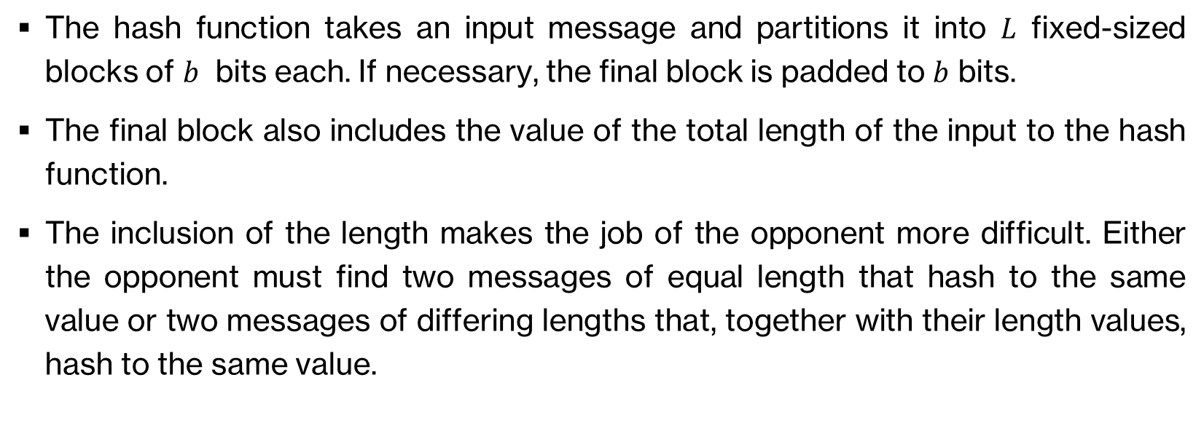
Cryptanalysis on Secure Hash Code
The hash function takes an input message and partitions it into $L$ fixed-sized blocks of $b$ bits each. If necessary, the final block is padded to $b$ bits.
The final block also includes the value of the total length of the input to the hash function.
The inclusion of the length makes the job of the opponent more difficult. Either the opponent must find two messages of equal length that hash to the same value or two messages of differing lengths that, together with their length values, hash to the same value.

Slide 46
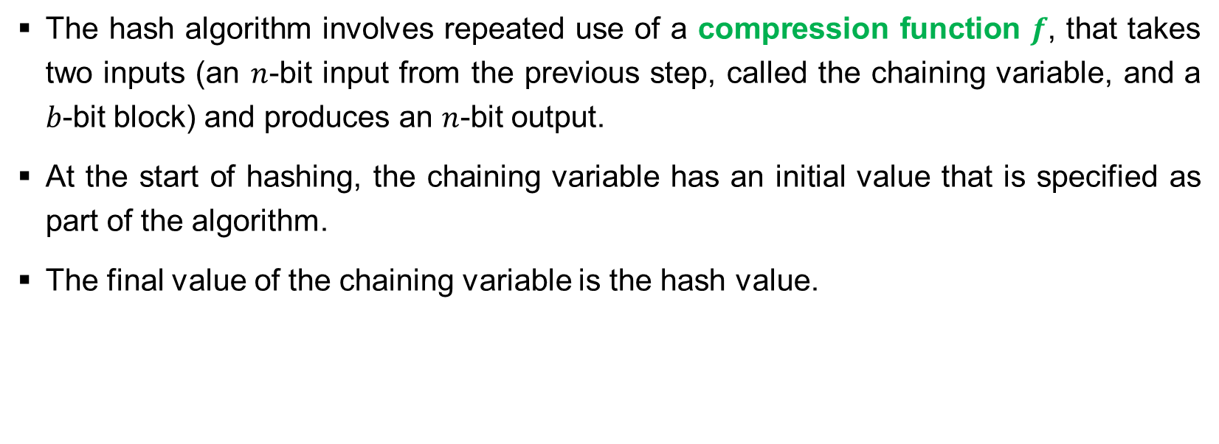
Cryptanalysis on Secure Hash Code
The hash algorithm involves repeated use of a compression function $f$, that takes two inputs (an $n$-bit input from the previous step, called the chaining variable, and a $b$-bit block) and produces an $n$-bit output.
At the start of hashing, the chaining variable has an initial value that is specified as part of the algorithm.
The final value of the chaining variable is the hash value.

Slide 47
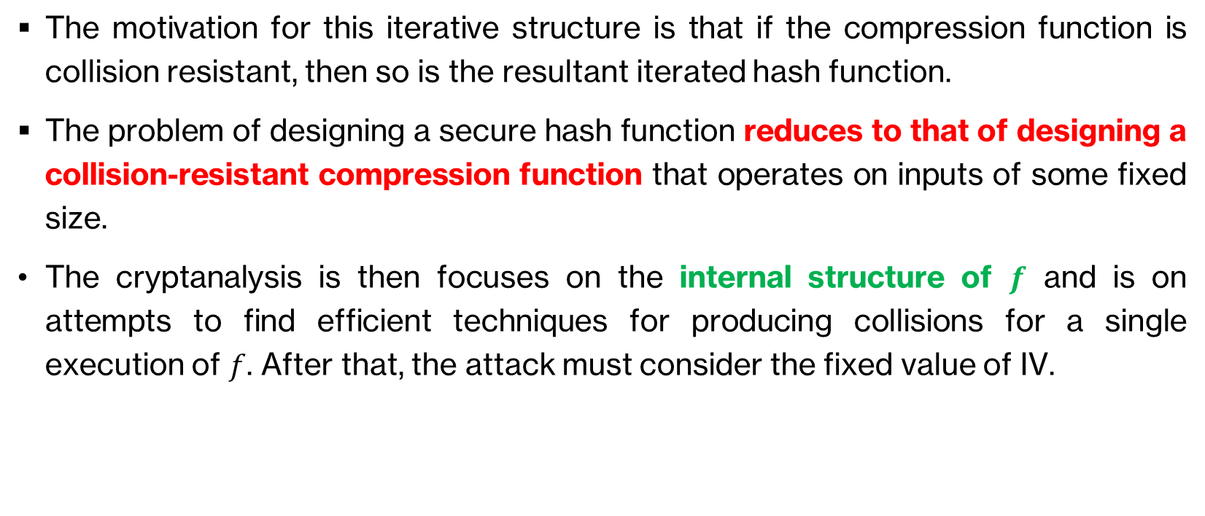
Cryptanalysis on Hash Function Secure Hash Code
The motivation for this iterative structure is that if the compression function is collision resistant, then so is the resultant iterated hash function.
The problem of designing a secure hash function reduces to that of designing a collision-resistant compression function that operates on inputs of some fixed size.
The cryptanalysis is then focuses on the internal structure of $f$ and is on attempts to find efficient techniques for producing collisions for a single execution of $f$. After that, the attack must consider the fixed value of IV.

Slide 48
TYPES OF PRACTICAL HASH FUNCTIONS

Slide 49
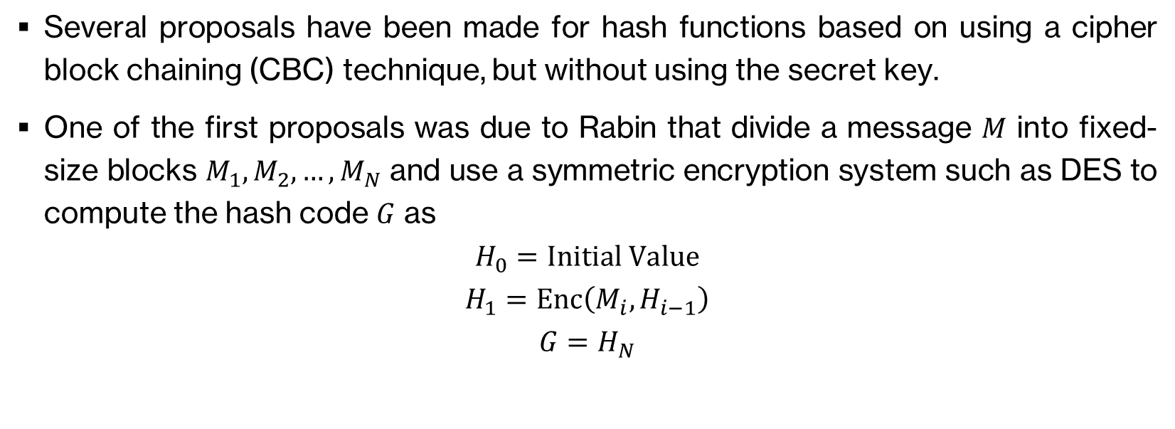
Practical Hash Function Based on Cipher Block Chaining (CBC)
Several proposals have been made for hash functions based on using a cipher block chaining (CBC) technique, but without using the secret key.
One of the first proposals was due to Rabin that divide a message $M$ into fixed-size blocks $M_{1},M_{2},…,M_{N}$ and use a symmetric encryption system such as DES to compute the hash code $G$ as
$$H_{0}=Initial Value$$
$$H_{1}=Enc\left(M_{i},H_{i−1}\right)$$
$$G=H_{N}$$

Slide 50
Practical Hash Function Based on Cipher Block Chaining (CBC)
The operation is similar to the CBC technique, but there is no secret key involved here.
As with any hash code, this scheme is subject to the birthday attack. If the encryption algorithm is DES and only a 64-bit hash code is produced, the system is vulnerable to meet-in-the-middle attack, for instance.
Another version of the birthday attack used even if the opponent has access to only one message and its valid signature and cannot obtain multiple signings.

Slide 51
Practical Hash Function Based on Cipher Block Chaining (CBC)
It can be shown that some form of birthday attack will succeed against any hash scheme involving the use of cipher block chaining without a secret key, provided that either the resulting hash code is small enough or that a larger hash code can be decomposed into independent subcodes.

Slide 52
Practical Hash Function – Message Digest Algorithm 5 (MD5)
The Message Digest Algorithm 5 (MD5) was developed by Ron Rivest in 1991 that generates 128-bit hash values.
It was standardised by IETF in RFC1321 and commonly used to authenticate files
It is no longer recommended to use since collision and other attacks possible.
However, if one simply copying a file from one place to another, MD5 will still do the job.

Slide 53
Practical Hash Function – Secure Hash Algorithm (SHA)
Secure Hash Algorithm (SHA) was originally designed by the National Institute of Standards and Technology (NIST) and published as a federal information processing standard (FIPS 180) in 1993. It was then revised as SHA-1 in 1995.
SHA is designed based on the hash function MD4 and produces 160-bit hash values.
In 2002 NIST produced a revised version of the standard that defined three new versions of SHA with hash value lengths of 256, 384, and 512, collectively known as SHA-2.

Slide 54
Practical Hash Function – Secure Hash Algorithm (SHA)

Slide 55
Practical Hash Function – Secure Hash Algorithm (SHA)
The real practical SHA algorithm is very complex and beyond our syllabus, hence we will not cover them here.
If you are interested to learn in details on how SHA-512 works, you can refer to Stallings’ book, Page 343 – 352, SHA-512 Logic for its elegant design and architecture.

Slide 56
Main References for Chapter 10
Stallings, W. “Cryptography and Network Security: Principles and Practices”, Fifth Edition, Pearson Prentice Hall, 2011.

Slide 57
~ THE END ☺ ~

